Slide 1






Piet de Visser - PDVBV
Partitioning
Positives and Pitfalls…
Piet de Visser
Simple Oracle DBA
Favorite Quotes: “The Limitation shows the master” (Goethe), “Simplicity is not a luxury, it is a necessity. Unfortunately, “Complex’ solutions sell better. (EW Dijkstra).

Slide 2














Logo Cloud
Portbase
(dutch gov)
Shell
Philips
ING bank
Nokia
Insinger, BNP
Etihad
NHS
BT
Claritas, Nielsen
Unilever
Exxon
GE
Don’t waste time on Self-Inflation… but Hey, this was such a cool Idea (from a marketing guy)…
Logos of my major customers over time. If you want your logo here: Hire me.

Slide 3

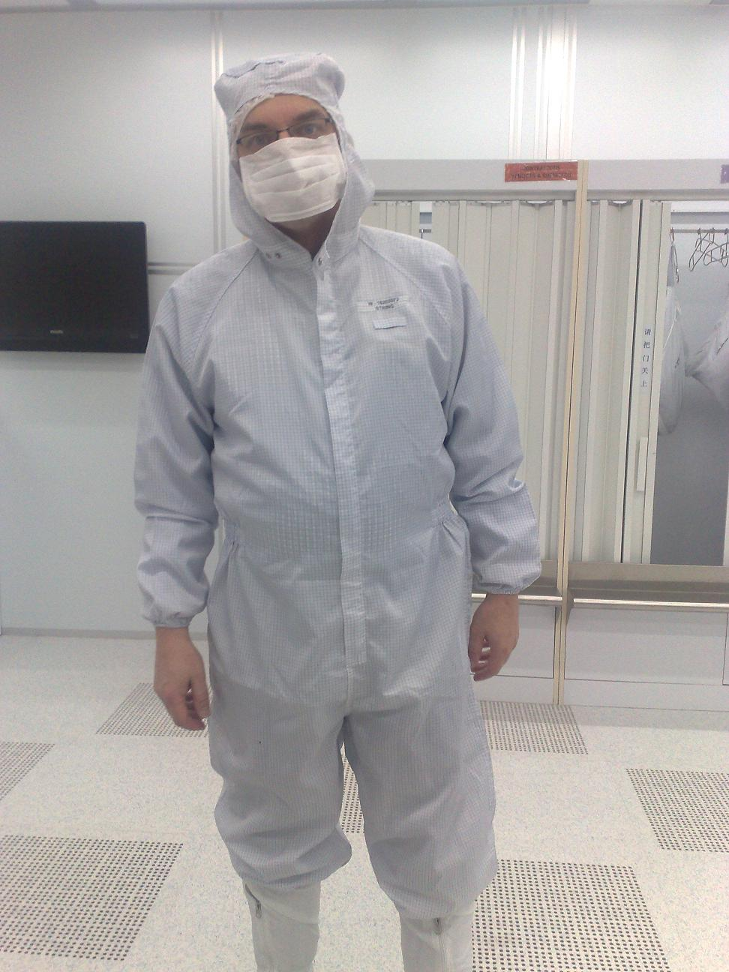
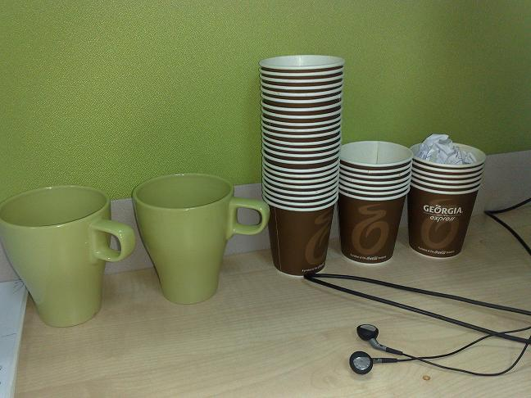
What does it look like..
Couldn’t resist… after this changing room, not allowed to take pictures anymore..
For travel pictures from Asia: later…

Slide 4
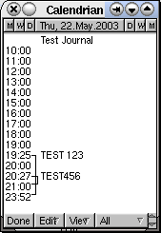
Agenda (45min +/- my “Dev” preso.. )
Partitioning…
Summary: Design !!
(see final slides. ;-) )
Top-Tip: Keep It Simple.
10+ min Discussion (Virtual ….???)
Agenda. No longer allowed when presenting online (c.f. Connor…)
Oh, BTW: I am known for Typos.. Find a typo = get a drink..

Slide 5
Basics; Why Paritioning ?
Partitioning: Split 1 table into “Many”
Two Main Advantages:
1. Avoid Redo
2. Scan less data on Qrys.
Many more… later.
Compress partitions..
Read-only, storage tiers
Partial indexing
Ref-partitions.
Hybrid Partitioned-tbls…. WOW!
Later (next month’s ppt...)
(paid-for-EE-option…) Two main Advantages, will try to illustrate both
Piffalls later… other advantages: later. (add coffee break…)

Slide 6
Table and Index. Conventional.
1
4
2
2
3
1
4
3
Table
(Global) Index on ID
A quick illustration of table and indexes…. Data in the tabler is randomly spread out,
but the inxexes contain ordered lists and pointers to thre table-records.

Slide 7
Partitioned tables… (and local index)
Smaller pieces
“known” content
Still 1 Table.
Local index !!
1
1
2
2
3
3
4
4
A quick illustration of (range) partitions and local indexes…. Partitions are just small tables with known (ranges) of data.. Oracle “Knows” those ranges.

Slide 8
Partitioned tables; Global index; Active=‘Y’
Table still Partitioned..
GLOBAL index,
Points to all Parts
N
1. Active=Y
N
2
N
3
Y
4 Active=Y
Global Index
illustration of GLOBAL indexes… The index is now One Single object, Pointing to all partitions.
The impact of this will be noted later: on Redo and on Queries.

Slide 9

1st Advantage: Less Redo (on delete…)
Ins / Upd / Del is “Work…”
Undo + Redo…
Redo = Arch = Stndby…
Delete?
Truncate or Drop is “Faster”
You Can! - Drop Partitions!
But…
Only if your partitioning is suitable.
Only on “delete” (or exchange partition)
Explain deleting old data with dorp-partition.
Typical use-case: ingest + remove of data with limited lifetime in the DB.. You can save half the redo..

Slide 10
Drop Partition… (Fast, no-redo)
SQL> Alter table PT drop partition PT_1 ;
1
1
2
2
3
3
4
4
Instantaeous Delete of the “range” inside a partition. Vry Little Effort.
Note: inserts and updates will still require redo… and Global indeses.. Well, just wait.

Slide 11
Partitioned tables; Global index; Active=‘Y’
SQL> Alter table PT drop partition PT_1 ;
N
1. Active=Y
N
2
N
3
Y
4 Active=Y
illustration of GLOBAL indexes… Can no longer “truncate” index, index points to whole range..
On “drop-partition, will need rebuild of index…

Slide 12
Demo time..
T = Table
PT = Partitioned table
Delete from T => redo
Delete from PT => still redo..
Drop partition => Much More Efficient..
SQL > @demo_part
SQL> @demo_part_0
SQL> @demo_part_0a (with global index…)
Explain deleting old data with dorp-partition.

Slide 13
2nd Advantage: (some) Queries Go Faster…
Scan Less Data
less blocks, less IO, less Cache
Typical use-case:
Queries / Aggregates over 1 or few Partitions.
Anti-pattern:
Loop over All Partitions… (later)
Next slides: show me how..
Ideally, queries scan as little data als possible to return results .. Fast
Redue the work…

Slide 14
Aggregates, FTS over Conventional table
Data all over the Table..
Select Sum (amt)
Where [range]
Group by ..
Probably FTS
4
2
1
3
Table
Data can be all over the table..
Hence FTS or inefficient range-scan + rowid-access needed…

Slide 15
Aggregates on Partitions: less data to scan?
IF… we know where to look..
Then… FTS on…
just 1 Part. ?
Design !
Know your data.
Control your SQL
1
2
3
4
Some (most) searches / scans can be limited to just the relevant partitions..
This Will Only Work if we can eliminate sufficient partitions. (Design!!). - note : No Indexes.

Slide 16
Demo time..
T (Table)
PT (partitioned)
Select Range, SUM(amt)
From T/PT
Where range Between 10000 and 19999
Group by Range;
SQL > @demo_part
SQL> @demo_sum
This is what we will see. In demo.. -- What do we Expect ?
(don’t forget to initiate the data)

Slide 17
More Queries: Find Specific Records
Where ID = :n
Find 1 record; Easy, use (local) index.
Where Active = ’Y’
Find Multiple records, all over…
Global index..? But … Redo?
Local Index..? But … How many Partitions ?
Anti-pattern:
Loop over All Partitions…
When you need “Fast” return of a small set, you need an index… Global or Local
But avoid having to loop/scan many partitions…

Slide 18
Conventional. QRY for 1 record; on PK/UK.
1
4
2
ID = 2 ?
PK lookup
2
3
1
4
3
Table
(Global) Index on ID
A quick illustration of table and indexes…. Data in the tabler is randomly spread out,
but the indexes contain ordered lists and pointers to the table-records.

Slide 19
Table, index… QRY for a set; Active=Y
N
4 (active=Y)
N
Active = ‘Y’ ?
Range Scan
2
N
1. (active=Y)
Y
3
Table
(Global) Index on active..
Same situation, different index.
The few active=Y fields can be all over the table (and in all partitions..).

Slide 20
Partitioned table + local index on PK
1
1
2
2
Id= 1 ?
3
3
4
CBO “knows”:
Only 1 partition…
4
Searching for the PK or partition key is Easy… Visit 1 local index, and find the record.
CBO can see from the where-clause which (local) index-partition it needs…

Slide 21
Global index; Active=‘Y’
N
1. Active=Y
N
2
Active=Y
N
3
Y
4 Active=Y
Global Index
illustration of GLOBAL indexes…. And the ups and downs, SQL is equally efficient as on ”Table”
But Point out the need for rebuild if you drop 1 partition: 25% of pointers is gone…

Slide 22
LOCAL index, active=Y…
1 Active=Y
N
-
N
Y
2
Active=Y
N
Y
3
N
Y
Now for 7 x 365 partitions..
4 Active=Y
Local Index
If the SQL does not gives us a clue for the Partittion,
We need to Search Through Every Local Index… (Parition-Range-All.. Looping)

Slide 23
Demo time..
PT (partitioned)
Select id, active
From PT
Where active = ‘Y’;
Compare GLOBAL and LOCAL index.
SQL > @demo_part
SQL > @demo_part_1
This is what we will see. In demo.. -- What do we Expect ?
(don’t forget to initiate the data)

Slide 24
Pitfalls; What to Avoid…
Avoid Global Indexes
Extra work on drop-partition
Avoid “Partition Range All”
Looping, multiplies the work…
Consequence:
All Qries Need “The Part-Key”
Up Front Design!
Two main Advantages, will try to illustrate both
Piffalls later… other advantages: later.

Slide 25
Bonus-Trick: a PK-Key for Partitioning. 1/2
(not saying this is a good idea…!)
Partitions = mostly a “date thing”
Not always: List-part on Cstmr-ID also happens.
No Global Indexing
Only 1 Unique Key
Hence UK = PK = Partition key.
(did I say: Up Front Design?)
If no GLOBAL index, and partition on date, then what will be my PK?
Suggestions ?

Slide 26
Bonus-Trick: a PK-Key for Partitioning. 2/2
Two part key (64bit integer)
Date: YYYY DDD SSSS
Sequence: nnnnnn, cycling at 999,999
Id = “epoch” + seq (16 digits)
Id = YYYY DDD SSSSS + seq (18 digits)
Id = YYYYMMDD HH24MISS + seq (20 digits)
Also check : “GUID as PK” (@franckpachot)
Bonus demo: SQL> @demo_part_pk
Lightbulb ?
Artificial PK, order-able, unique on 1M/sec, integer hence small+efficient.
More Suggestions ? DISCUSS!!

Slide 27


Summary (the watch of the cstmr)
Partitioning: Only From Design.
Don’t use Global indexes (yet..?)
All (fast) Queries need the Partition Key.
Use(ful) Cases:
Limited ( it is not “cloud” …)
Time Series
Fast Moving data (batch-deletions…)
List partitioning = Sharding (discuss !)
Know + Control your Database + App.
In my opinion: For Large sets of fast moving, time-ordered data.
You must understand the limitations! (before digging deeper… )

Slide 28
Interesting Times Ahead…
Many Improvements
(global indexes – are improving)
Many New Features.
Partial indexing
Ref-partitions
Hybrid Partitioned-tbls…. Wow ??!
Discuss
What should be in next month’s ppt...
Watch this space…
Many interesting things ahead.

Slide 29

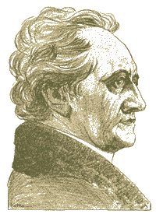
Don’t Take my word for it…
RTFM: start with concept-guides
@sdjh2000 (Hermann Baer @ Oracle)
Simplicity
In case of doubt: Simplify!
SimpleOracleDba . Blogspot . com (ramblings)
@pdevisser (twitter)
Firefox
literature
Goethe ______________........ (simplicity)
Majority of times, I have been WRONG.
So go see for yourself - but don’t complicate life.

Slide 30


Quick Q & A (3 min ;-) 3 .. 2 .. 1 .. Zero
Questions ?
Reactions ?
Experiences from the audience ?
Question and Answer time. Discussion welcome (what about that Razor?)
Teach me something: Tell me where you do NOT AGREE.

Slide 31
Other Paths into data: IOT 1/3
Index Organized Tables
Overloading to the extreme: all data in the PK.
Group and Order data by leading columns
Ideal for Parent-child tables: Children Forced together.
Also Good for (small) Lookup-tables (TomK, RichardF)
IOT : one less segment..:
Thumbs
UP
PK + Data
(IOT)
Index
(UK)
Index
(other)
IOTs simply don’t have “tables”, all data is in the PK.
You have one less segment, there is no more table, no more un-ordered heap of records…

Slide 32
IOTs only get Better… 2/3
Bonus-feature on IOTs: Fat Indexes
2ndary indexes are “overloaded”
contain the PK-values (as rowid) to allow Access to PK (+data)
Good for n:m relationships and join-only access
Normally, you need TBL + PK + FK
(you can “overload” to get index-only-access)
The IOT does the overloading for you…
And removes the “table” segment altogether.
n,m
n,m
m,n
Show grouping + bonus-feature. SQL > @cr_di2.sql
2ndary indexes merit a good look! Neat Trick nr #2: automatic overloading.
Deep-down-wishlist: use 2ndary indexes as overflow-segment…. Too complicated for Fast-ppt ?

Slide 33

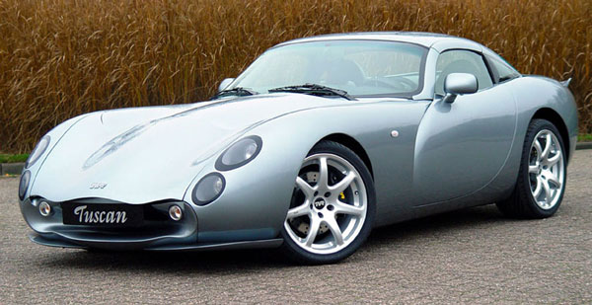
IOTs – downsides 3/3
Slow DML (ins/upd)
Especially Bulk & Batches, no “direct” insert
(people are used to bulk-loading without any indexes…)
Overflow Segment with extra columns.
Plan it – don’t get taken by surprise.
2ndary indexes are bigger
“Table” access is slower, Row-Guess(?), more “hops”
Statistics take forever (older versions?).
Bugs… (ML 471479.1 + more)
Image:
TVR
Downsides are non-negigable, as one customer noted… (ML: ) Suspect extra redo, need to test.
Wishlist: Prevent Overflow segments, or control overflow to go into 2ndary Index (e.g. avoid any heap-segment)

Slide 34
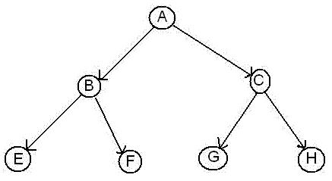
Recap 1/2
Any (Btree) index is: Data + pointers, stored in order
Index + statement, (DBA and Dev) must work together:
Good: Leading columns in the Where-clause
Better: All where-conditions in the index (smallest slice)
Even Better: Order-by from Index, Prevent sort
Best: All data from Index, don’t visit the Table
Various books, but … Tapio Lahdenmäki !
All you need to know about “good” indexing.
Demos: index, overloading, IOT.
Image:
Road map
Tapio : “the book” on indexes. 1, 2, 3 stars and Fat-indexes.
Demo: cr_di.sql (create demo index) – show explain, shnow nr-gets per sql.

Slide 35

Recap 2/2 : INDEXING
Verify Access Paths (especially on OLTP):
Explain, (auto)trace and check v$sql and v$sql_plan
Good Indexing: good, better, best…
will help you more then anything
Overloading is useful
Index-Compression is useful (but test)
Clusters and IOTs … If applicable (but test)
Now for the C-B-O… (paracetamol…)
Just to stress – and this is striclty my own humble opinion, but I will shout it aloud!
Do you notice we havnt lost any time / sleep over CBO yet ?

Slide 36


Optional Intermezzo: Poll for audience
Thank You !
Stay Tuned
(not done yet…)
Who has/knows/uses:
Log-file-sync waits (how many TPS?)
Buff-busy waits (what segments?)
Gets/exe of critical queries ?
Fat or Overloaded Indexes ?
Clusters ? IOTs ?
Outlines, SQLPlans,
Hints
Early morning cursor-shooting
Lock or Restore Stats ?
Find out from the audience.
Bonus question: who prefers init-files ?

Slide 37
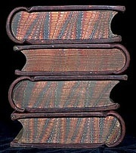
Eh, just to remind you … Simplicity
Leonardo da Vinci:
Simplicity is the ultimate sophistication.
Goethe:
In der Beschränkung zeigt sich der Meister".
EW Dijkstra:
Simplicity is a pre-requisite for reliability.
The sore truth is that Complexity sells better
www.brainyquote.com,
Quotes from Leonardo da Vinci, Albert Einstein, and Edsgar W Dijkstra.

Slide 38
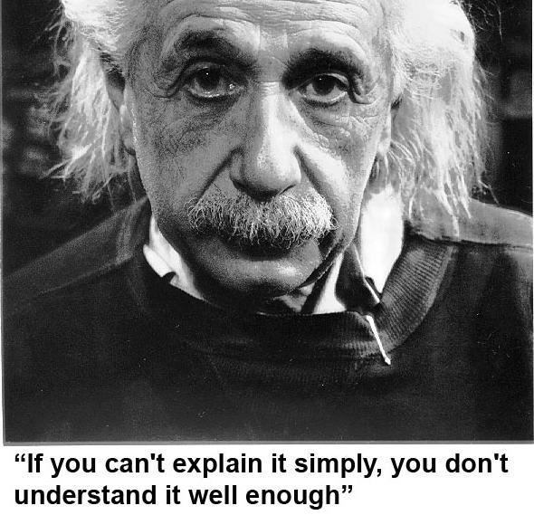
He got it …
As Simple as Possible, but not too simple
Simplicity is a Requirement - but Comlexity just sells better (EWD).

Slide 39

Take-aways for “Architects” + DBAs
Define Efficiency:
Get a feeling for your system – Statspack, AWR, v$sql
INDEXING : all Access should be “efficient” – check!
CBO: be lazy, dont tweak (not too much).
Stats: Auto-gather, and use a window
Trust but Verify : save SPM plans for a rainy day
Inspect your stats on problem-qries/tables.
Tweaks (set-stats, use SPM)
Sometimes you have to…
Minimize and simplify
Oh, and “Oracle is Great, and Larry is its CTO” … (I have to say this now that I got “ace”)

Slide 40

Notes
Road + map are good metophores.
Occams Razor
Least possible ASSumptions
Simplest Solution.
LoE: Layer of Expertise ( © to Moans for this abbrev.?)
Simplicity at each Layer of Expertise is essential for a robust system.

Slide 41

CBO basics
CBO is like TomTom (= Garmin); Very Clever, but…
Do you ever mess with your Tomtom ?
You need good Roads - hence my rant on Indexes.
TomTom needs “the map”
TomTom needs good “settings”
Sometimes it needs common sense
Hints, sqlplans, SPM.
And Somtimes it needs a Spanking.
CBO… sooo much to it! I can only begin to scratch the surface…
When TomTom goes bananas, you don’t 10053 on it, nor change the settings: you use a map + brains…

Slide 42


What do these have in common…
SQL > COMMENT on table emp is ‘you are it’;
SQL > GRANT select on emp to perfstat;
SQL > ANALYZE table emp estimate statistics ;
SQL > alter system flush shared_pool;
SQL > .. You may have more of these …
Pre-11 shooting of a cursor!
Never quite “precise”, but they generally work.
New: dbms_shared_pool.purge( cursor ) (c/o “Prutser”)
Images:
Grenade
Scalpel
Early morning shooting… In ora 11, there is a method.. Check Harald v Brederode.
“Precise, targeted Fixes” are always better the “generic” settings.

Slide 43

CBO runs on Information 1/3
Spfile-parameters
System stats
Object Stats
Session-parameters
Outlines or SQLPlans
Hints (if you really have to…)
(and … sometimes it “needs to get lucky” – c/o JL)
Realize the hierarchy: Order
Troubleshoot from bottom to top!
There is a hierarchy in the information used by CBO. Troubleshooting should take this into account.
Start with changes that are “precise”, aimed at your problem-only, prevent wider impact of “tweaks”

Slide 44
Impact on the CBO … 2/3
Spfile: Simplify; get rid of ALL init.ora “history”.
Any change = system wide (Don’t Mess here!)
Optimizer_mode… (dflt Choose is fine)
Hash-/Sort-area-size (Session level, if at all)
System Statistics (often overlooked):
Gather on your hardware (CPUs, disk-behaviour)
Tip: Collect + Plot over time, get a feel for your system.
Set system-stats manual ?…
(See book by Christian Antognini, but Need more Info)
System stats tend to vary, notably if hardware changes (vmware, dynamic hardware provisioning) and SAN behaviour over the day – re-check the book and the docu! Funny: ML 368252.1 (for EBS users)

Slide 45
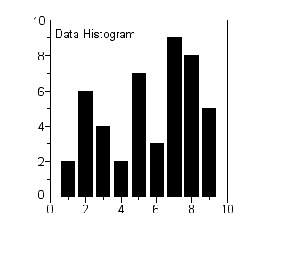
CBO needs More Information 3/3
Session-parameters
Override Spfile-parameters – for duration of session.
(I don’t mess with these, but you can…, optimizer_mode)
Object Statistics
DBMS_STATS (But I “analyze” when in a hurry)
Can be “Set”, copied, tweaked.
In doubt: use worst-case stats and LOCK.
if it works on 60M, it works on 120 records too.
New Month, New Partitions: Stale.
Session settings will (only) last for the session. Beware how long your session lasts.
Table/index_stats will auto-gather… do you want that ? What about new, “empty” objects ?

Slide 46

Gathering Stats.. (old disucssion) 1/2
Simplify ( be Lazy): Use default gather_stats_job
Gather_database_stats_job ( internal use only … ?)
DBMS_STATS = Heavy (and unpredictable)
Check the Maintenance Window
(and learn to use the scheduler )
Save Stats you trust – for re-import (=effort?)
10g: Restore-stats: Safety-net.
Retention of 31 days…
Image
Lazy
Long and hard discussions on “when + how to analyze” Just do auto-gather + stale… but…
Beware of the Job, control the window. Nb: Restore is different from exp/imp stats !

Slide 47

Gathering Stats.. 2/2
Stale, 10%... : Lock stats you trust! (but how long…?)
Check for stale anyway (=work…).
Locking of stats: for any use of the segment
Locking of SQL (hint, outline, sqlplan) : per stmnt…)
By Exception only: set or tweak stats.
Volatile tables, GTTs … maybe… (I hestiate, ... more work…)
“Upgrade took two weeks to stabilize…” (Thx!)
You need an upgrade-strategy,
Whitepaper + outlines/SQLplans!
Complications around gathering stats… sigh… the “automation” is good, but beware of unpredictable changes.
10%-stale is a bit low. Lock the ones you trust. Upgrade was my intro into “outlines”

Slide 48

Outlines: an “Emergency” strategy
I never liked outlines: too much hassle, but..
I Discovered their use on upgrades from 9 to 10.
IF you can afford to do this (1 hr work):
Get outlines of all major queries when “Good”
Then either lock m in place.
Or keep m for use and reference when needed.
This is SQL-Plan management by another name..
But I’m not on 11g yet…
Image
Lock
Collect Outlines when the system is running “as intended” and keep those just-in-case.
You can then activate one or more outlines when queries go out of control (non-intrusive!)

Slide 49
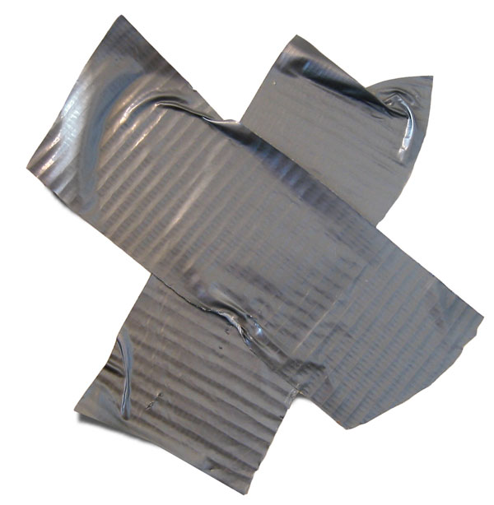

Hints… Necessary Evil
Hints are EVIL
Gremlins, time-bombs (job security?)
Maybe: on GTTs
Dynamic sampling (tt, 1) (c/o JLewis)
Possibly on “The-Cast-table” in PL/SQL
Tell CBO what is in your array
You can “catch” a hint from dbms_xplan…
(demo_outline_hint.sql – how to get in trouble…)
Hints… ongoing work… on GTT: dynamic-smple, or cardinality or ordered…
Hint (outlines) can be “gotten” form dbms_Xplan now! (11gr2: IGNORE_ROW_ON_DUPKEY_INDEX .. ? Later!)

Slide 50
Outlines (and plans)
There is a lot to outlines and “plan management”
It it becomes (complicated) tweaking….
It is probably too … complicated.
Think of an easier way !
Good indexing – good INDEXING…
Shoot qrys (but cant do that forever)
Try New, better stats
Outlines – just in case
Image ?
Time.. You cant tweak CBO forever, no matter how much Oracle wants you to…
Did I mention “good Indexing” ?

Slide 51


Keep the clipart
Frozen Plans.
More..

Slide 52


Keep the clipart
Thu, 18Feb, 11:15 (one one one five...)
Hall …,
the SIMPLE approach to Indexing and CBO
Same time: many real celebrities presenting
User Managed: Flexible, but “You run it” Dataguard: covers almost any-outage, user-errors, machine-failure, site-disasters, and great for “other usages”

